Slide 1
Microsoft Visual C#: An Introduction to Object-Oriented Programming
7th Edition
Chapter 12
Using Controls
© 2018 Cengage. All Rights Reserved. May not be copied, scanned, or duplicated, in whole or in part, except for use as permitted in a license distributed with a certain product or service or otherwise on a password-protected website for classroom use.

Slide 2
Objectives (1 of 2)
12.1 Use Controls
12.2 Understand the IDE’s automatically generated code
12.3 Set a Control’s Font
12.4 Create a Form that contains LinkLabels
12.5 Add color to a Form
12.6 Add CheckBox and RadioButton objects to a Form
12.7 Add a PictureBox to a Form
© 2018 Cengage. May not be copied, scanned, or duplicated, in whole or in part, except for use as permitted in a license distributed with a certain product or service or otherwise on a password-protected website for classroom use.

Slide 3
Objectives (2 of 2)
12.8 Add ListBox, ComboBox, and CheckedListBox items to a Form
12.9 Add a MonthCalendar and DateTimePicker to a Form
12.10 Work with a Form’s layout
12.11 Add a MenuStrip to a Form
12.12 Use other controls
© 2018 Cengage. May not be copied, scanned, or duplicated, in whole or in part, except for use as permitted in a license distributed with a certain product or service or otherwise on a password-protected website for classroom use.

Slide 4
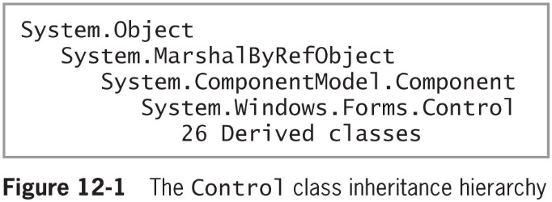
Understanding Controls
Control class
Provides the definitions for GUI objects
Component class
Provides containment and cleanup for other objects
© 2018 Cengage. May not be copied, scanned, or duplicated, in whole or in part, except for use as permitted in a license distributed with a certain product or service or otherwise on a password-protected website for classroom use.

Slide 5
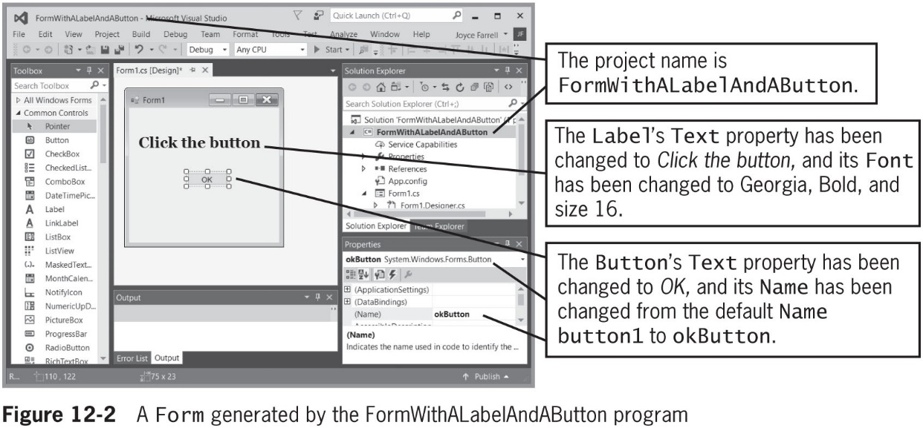
Examining the IDE’s Automatically Generated Code (1 of 4)
Figure 12-2 shows a Form created in the IDE
© 2018 Cengage. May not be copied, scanned, or duplicated, in whole or in part, except for use as permitted in a license distributed with a certain product or service or otherwise on a password-protected website for classroom use.

Slide 6
Examining the IDE’s Automatically Generated Code (2 of 4)
The following actions have been performed (see Figure 12-2):
A new Windows Forms project has been started and given the name FormWithALabelAndAButton
A Label has been dragged onto Form1 and its properties updated
A Button has been dragged onto Form1 and its properties updated
Within the Form1.Designer.cs file in Visual Studio, two lines of code are generated as follows:
private System.Windows.Forms.Label label1;
private System.Windows.Forms.Button okButton;
© 2018 Cengage. May not be copied, scanned, or duplicated, in whole or in part, except for use as permitted in a license distributed with a certain product or service or otherwise on a password-protected website for classroom use.

Slide 7
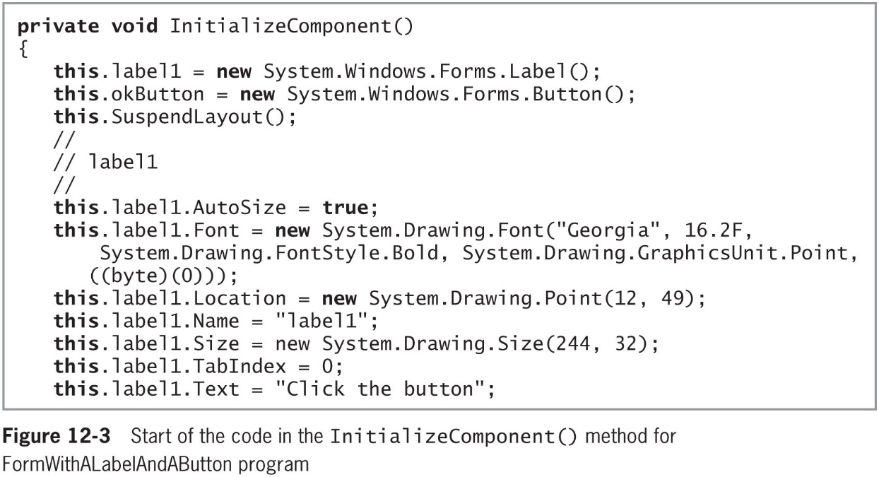
Examining the IDE’s Automatically Generated Code (3 of 4)
Figure 12-3 shows the first part of code that calls constructors for the Button and Label objects and sets a number of properties for the Label
© 2018 Cengage. May not be copied, scanned, or duplicated, in whole or in part, except for use as permitted in a license distributed with a certain product or service or otherwise on a password-protected website for classroom use.

Slide 8
Examining the IDE’s Automatically Generated Code (4 of 4)
Figure 12-3 contains the following:
After the InitializeComponent() method header and opening brace, the next two statements call the constructor for each control that the programmer dragged onto the Form, which create the actual objects
The next statement is a method call as follows:
This.SuspendLayout();
Comments that start with forward slashes serve to separate the label1 code from other code in the method
The InitializeComponent() method ends with statements that set the properties of the Form
In the code in Figure 12-3 every instance of this means “this Form”
© 2018 Cengage. May not be copied, scanned, or duplicated, in whole or in part, except for use as permitted in a license distributed with a certain product or service or otherwise on a password-protected website for classroom use.

Slide 9
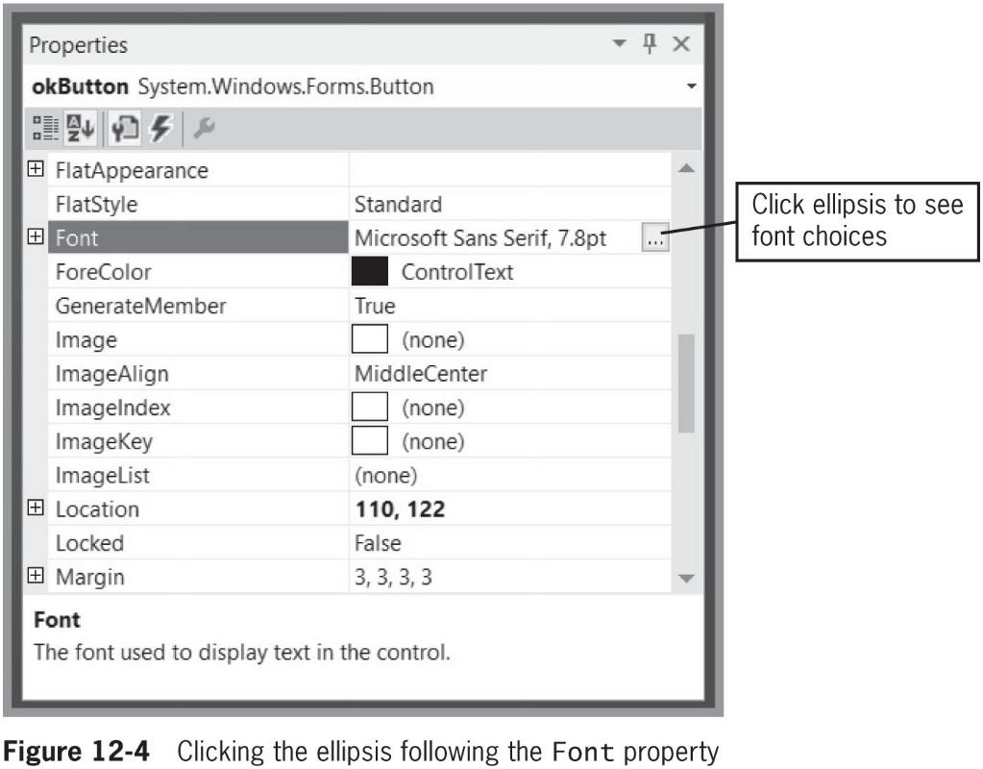
Setting a Control’s Font (1 of 3)
Use the Font class to change the appearance of printed text on your Forms
© 2018 Cengage. May not be copied, scanned, or duplicated, in whole or in part, except for use as permitted in a license distributed with a certain product or service or otherwise on a password-protected website for classroom use.

Slide 10
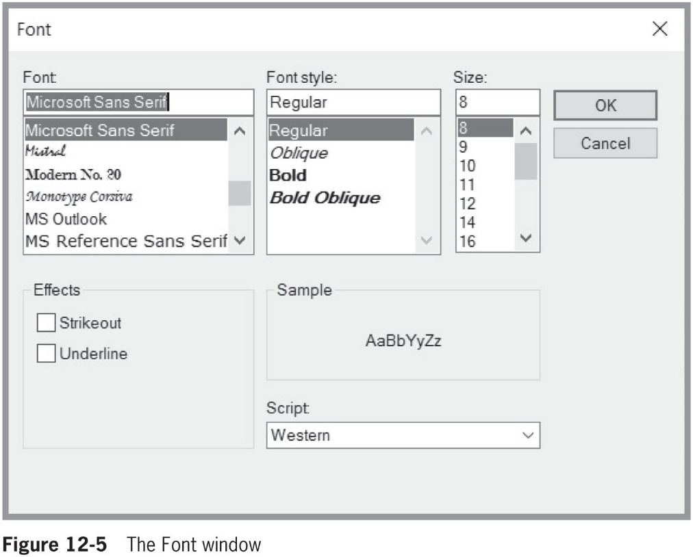
Setting a Control’s Font (2 of 3)
© 2018 Cengage. May not be copied, scanned, or duplicated, in whole or in part, except for use as permitted in a license distributed with a certain product or service or otherwise on a password-protected website for classroom use.

Slide 11
Setting a Control’s Font (3 of 3)
Change the appearance of printed text using code
Create your own instance of the Font class
The class includes a number of overloaded constructors
Example:
System.Drawing.Font bigFont = new
System.Drawing.Font("Courier New", 16.5f);
this.label1.Font = bigFont;
this.okButton.Font = bigFont;
© 2018 Cengage. May not be copied, scanned, or duplicated, in whole or in part, except for use as permitted in a license distributed with a certain product or service or otherwise on a password-protected website for classroom use.

Slide 12
Using a LinkLabel (1 of 5)
LinkLabel
Similar to a Label
Provides the additional capability to link the user to other sources such as Web pages or files
Default event
The method whose shell is automatically created when you double-click the Control
The method you are most likely to alter with Control
The event that users most likely expect to generate when they encounter the Control in a working application
© 2018 Cengage. May not be copied, scanned, or duplicated, in whole or in part, except for use as permitted in a license distributed with a certain product or service or otherwise on a password-protected website for classroom use.

Slide 13
Using a LinkLabel (2 of 5)
LinkLabel appears as underlined text
The text is blue by default
When you pass the mouse pointer over a LinkLabel, the pointer changes to a hand
When a user clicks a LinkLabel, it generates a click event
Executing a LinkClicked() method
The LinkVisited property can be set to true when you determine that a user has clicked a link
This setting indicates that the link should be displayed in a different color so the user can see the link has been visited
© 2018 Cengage. May not be copied, scanned, or duplicated, in whole or in part, except for use as permitted in a license distributed with a certain product or service or otherwise on a password-protected website for classroom use.

Slide 14
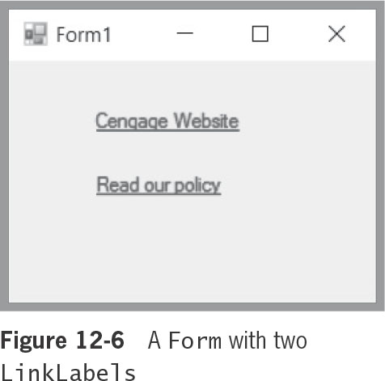
Using a LinkLabel (3 of 5)
© 2018 Cengage. May not be copied, scanned, or duplicated, in whole or in part, except for use as permitted in a license distributed with a certain product or service or otherwise on a password-protected website for classroom use.

Slide 15
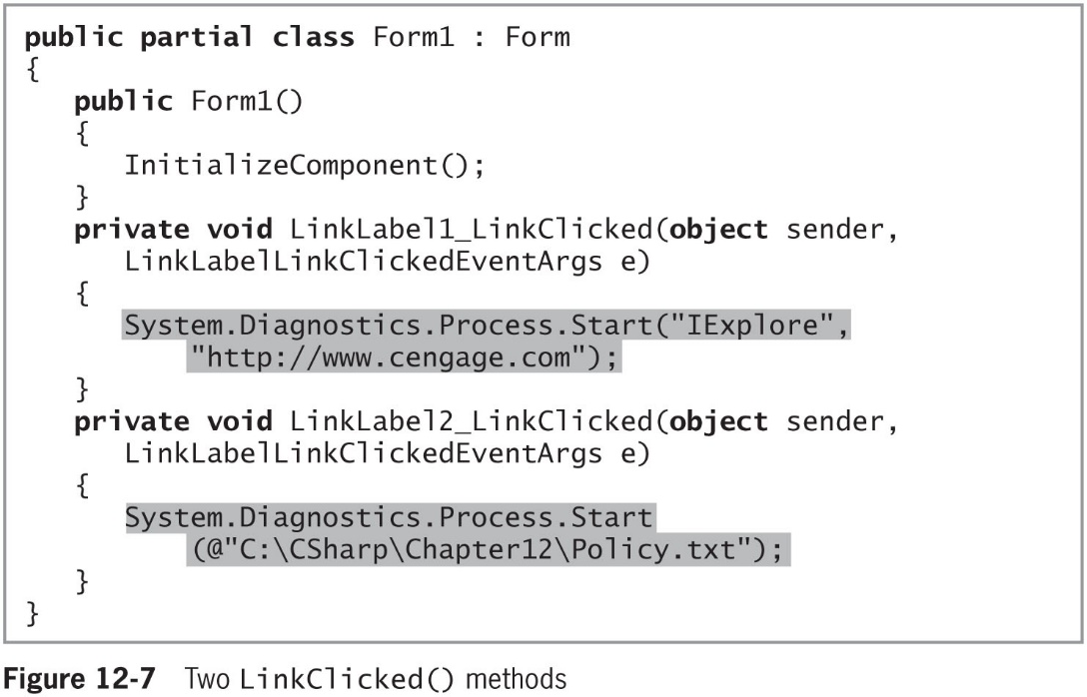
Using a LinkLabel (4 of 5)
© 2018 Cengage. May not be copied, scanned, or duplicated, in whole or in part, except for use as permitted in a license distributed with a certain product or service or otherwise on a password-protected website for classroom use.

Slide 16
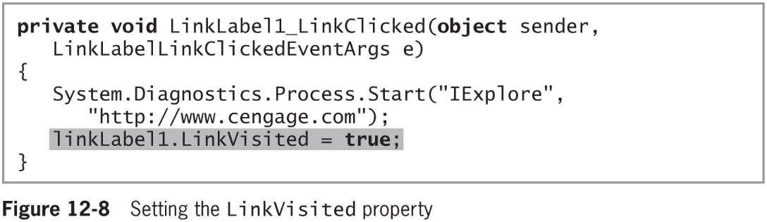
Using a LinkLabel (5 of 5)
© 2018 Cengage. May not be copied, scanned, or duplicated, in whole or in part, except for use as permitted in a license distributed with a certain product or service or otherwise on a password-protected website for classroom use.

Slide 17
Adding Color to a Form
Color class
Contains a wide variety of predefined Colors that you can use with your Controls
this.label1.BackColor = System.Drawing.Color.Blue;
this.label1.ForeColor = System.Drawing.Color.Gold;
When you are designing a Form you can choose colors from a list next to the BackColor and ForeColor properties in the IDE’s Properties list
© 2018 Cengage. May not be copied, scanned, or duplicated, in whole or in part, except for use as permitted in a license distributed with a certain product or service or otherwise on a password-protected website for classroom use.

Slide 18
Creating Loops with the while Statement (1 of 5)
CheckBox
Objects used to select or deselect an option
RadioButtons
Similar to CheckBoxes but only one RadioButton in a group can be selected at a time
Access Key – An ampersand ( & ) before a letter in the text property created a keyboard shortcut
When you add CheckBox and RadioButton objects to a form
They automatically are named using the same conventions you have seen with Buttons and Labels (first CheckBox is assigned checkBox1 by default)
© 2018 Cengage. May not be copied, scanned, or duplicated, in whole or in part, except for use as permitted in a license distributed with a certain product or service or otherwise on a password-protected website for classroom use.

Slide 19
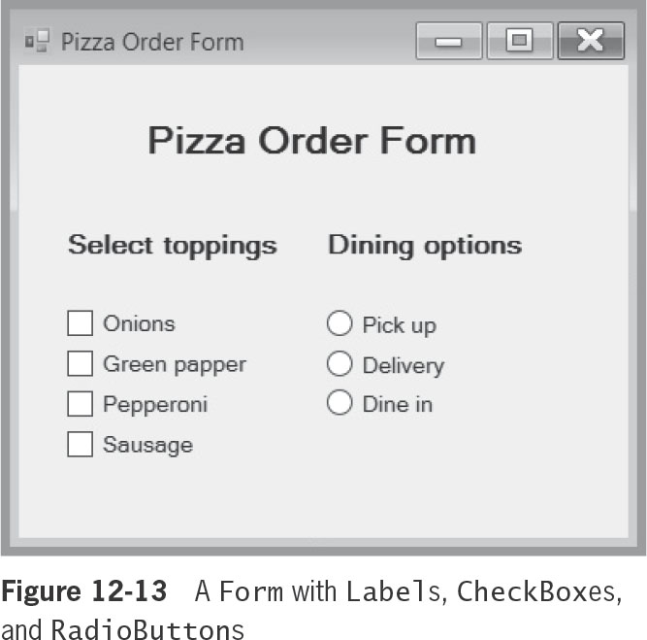
Creating Loops with the while Statement (2 of 5)
Figure 12-13 shows an example of a Form with which a user can select pizza options
Contains several Labels, CheckBox objects, and RadioButton objects
© 2018 Cengage. May not be copied, scanned, or duplicated, in whole or in part, except for use as permitted in a license distributed with a certain product or service or otherwise on a password-protected website for classroom use.

Slide 20
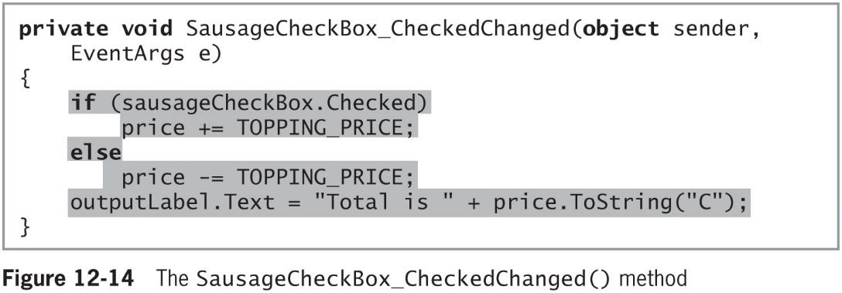
Creating Loops with the while Statement (3 of 5)
Figure 12-14 shows the code you would add to the Form.cs file for the application
© 2018 Cengage. May not be copied, scanned, or duplicated, in whole or in part, except for use as permitted in a license distributed with a certain product or service or otherwise on a password-protected website for classroom use.

Slide 21
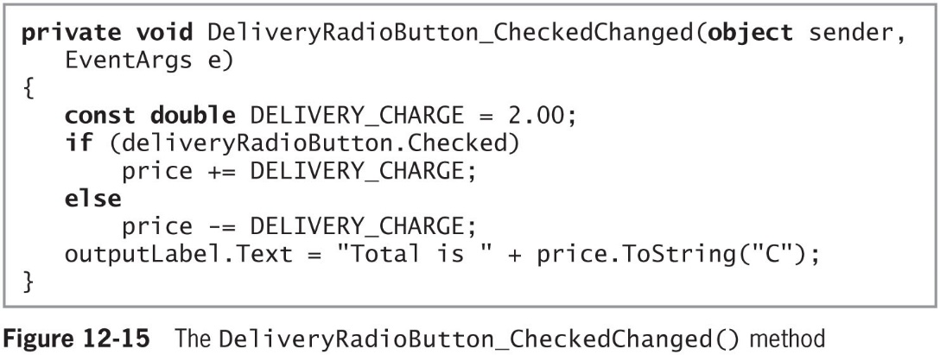
Creating Loops with the while Statement (4 of 5)
Figure 12-15 shows the code for DeliveryRadioButton_CheckedChanged()
© 2018 Cengage. May not be copied, scanned, or duplicated, in whole or in part, except for use as permitted in a license distributed with a certain product or service or otherwise on a password-protected website for classroom use.

Slide 22
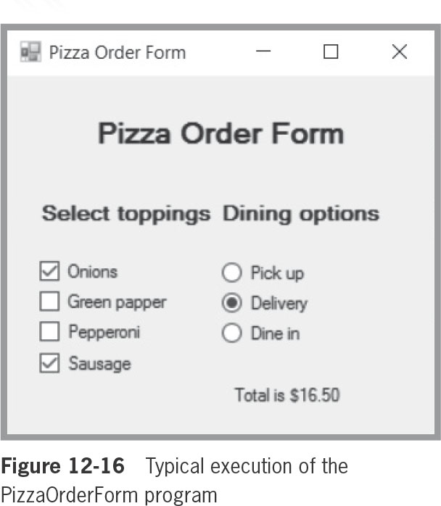
Creating Loops with the while Statement (5 of 5)
Figure 12-16 shows a typical execution of the PizzaOrder program after it is complete
© 2018 Cengage. May not be copied, scanned, or duplicated, in whole or in part, except for use as permitted in a license distributed with a certain product or service or otherwise on a password-protected website for classroom use.

Slide 23
Adding a PictureBox to a Form (1 of 4)
PictureBox
A Control in which you can display graphics from a bitmap, icon, JPEG, GIF, or other image file type
You can easily drag a PictureBox Control onto a Form in the Visual Studio IDE
Figure 12-17 (see next slide) shows a new project in the IDE with the following the following tasks completed:
A project was started
The Form Text property was changed to PictureBox Demo
The Form BackColor property was changed to White
A PictureBox was dragged onto the Form
© 2018 Cengage. May not be copied, scanned, or duplicated, in whole or in part, except for use as permitted in a license distributed with a certain product or service or otherwise on a password-protected website for classroom use.

Slide 24
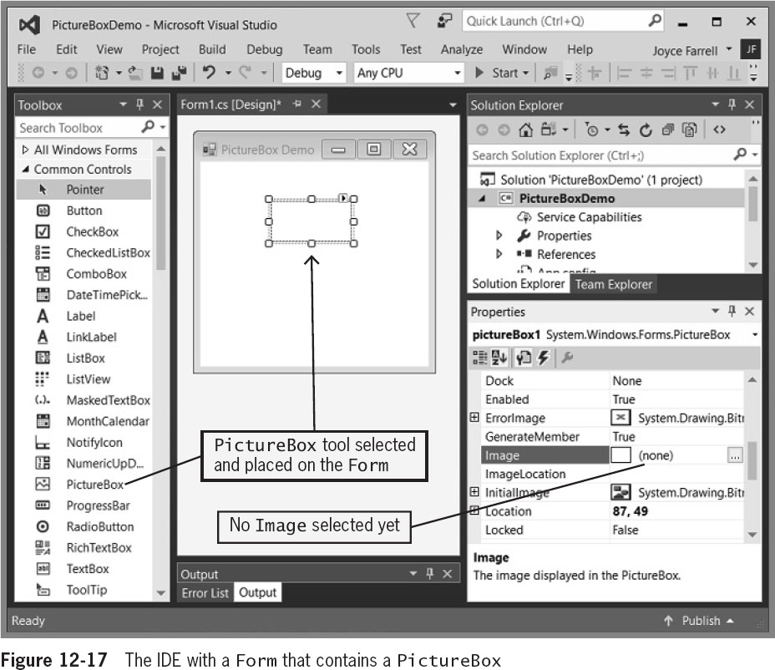
Adding a PictureBox to a Form (2 of 4)
© 2018 Cengage. May not be copied, scanned, or duplicated, in whole or in part, except for use as permitted in a license distributed with a certain product or service or otherwise on a password-protected website for classroom use.

Slide 25
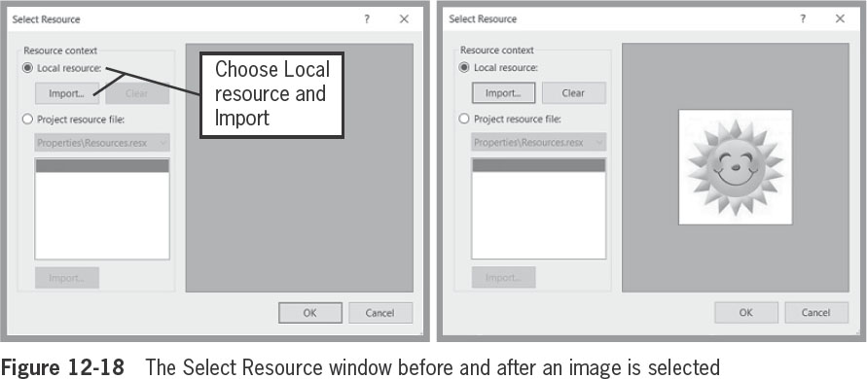
Adding a PictureBox to a Form (3 of 4)
© 2018 Cengage. May not be copied, scanned, or duplicated, in whole or in part, except for use as permitted in a license distributed with a certain product or service or otherwise on a password-protected website for classroom use.

Slide 26
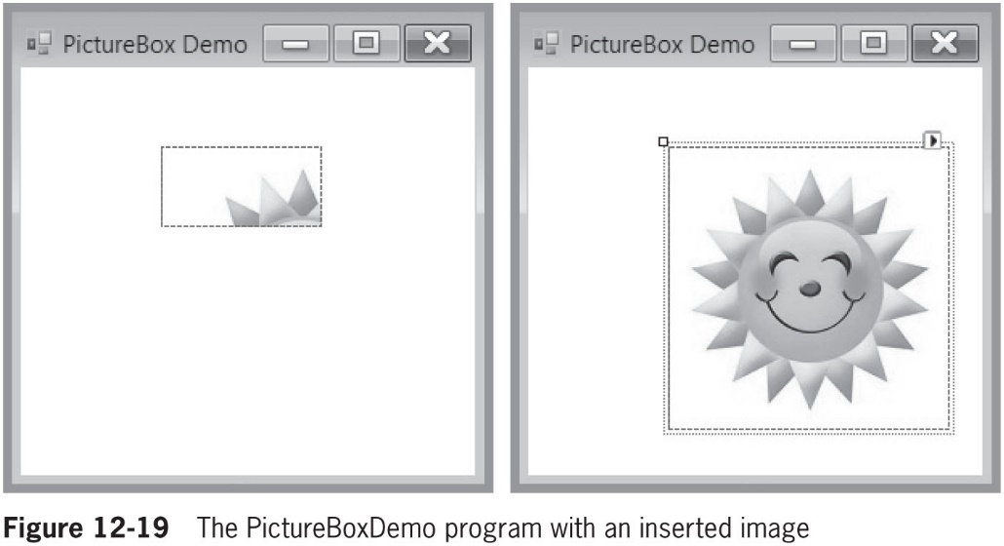
Adding a PictureBox to a Form (4 of 4)
© 2018 Cengage. May not be copied, scanned, or duplicated, in whole or in part, except for use as permitted in a license distributed with a certain product or service or otherwise on a password-protected website for classroom use.

Slide 27
Adding ListBox, CheckedListBox, and ComboBox Controls to a Form (1 of 7)
ListBox, ComboBox, and CheckedListBox objects
Allow users to select choices from a list
Three classes that descend from ListControl
ListBox
Displays a list of items the user can select by clicking
Allows the user to make a single selection or multiple selections by setting the SelectionMode property
SelectedItem property
Contains the value of the item a user has selected
© 2018 Cengage. May not be copied, scanned, or duplicated, in whole or in part, except for use as permitted in a license distributed with a certain product or service or otherwise on a password-protected website for classroom use.

Slide 28
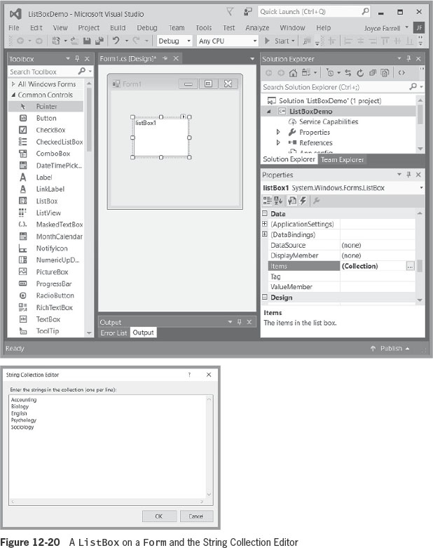
Adding ListBox, CheckedListBox, and ComboBox Controls to a Form (2 of 7)
© 2018 Cengage. May not be copied, scanned, or duplicated, in whole or in part, except for use as permitted in a license distributed with a certain product or service or otherwise on a password-protected website for classroom use.

Slide 29
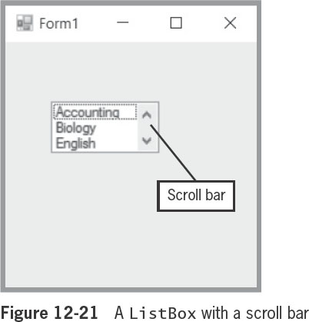
Adding ListBox, CheckedListBox, and ComboBox Controls to a Form (3 of 7)
Figure 12-21 shows that a scroll bar is provided automatically when you size a ListBox so that all items cannot be displayed at the same time
© 2018 Cengage. May not be copied, scanned, or duplicated, in whole or in part, except for use as permitted in a license distributed with a certain product or service or otherwise on a password-protected website for classroom use.

Slide 30
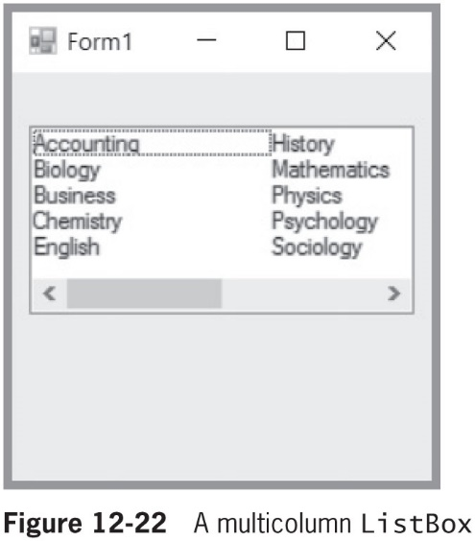
Adding ListBox, CheckedListBox, and ComboBox Controls to a Form (4 of 7)
Figure 12-22 shows a multi-column list box to which 10 strings have been added
© 2018 Cengage. May not be copied, scanned, or duplicated, in whole or in part, except for use as permitted in a license distributed with a certain product or service or otherwise on a password-protected website for classroom use.

Slide 31
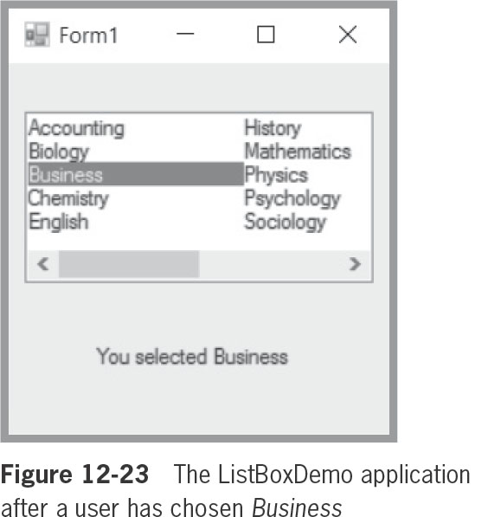
Adding ListBox, CheckedListBox, and ComboBox Controls to a Form (5 of 7)
© 2018 Cengage. May not be copied, scanned, or duplicated, in whole or in part, except for use as permitted in a license distributed with a certain product or service or otherwise on a password-protected website for classroom use.

Slide 32
Adding ListBox, CheckedListBox, and ComboBox Controls to a Form (6 of 7)
ComboBox Control
Combination of a ListBox and an editing control
Allows the user to select from the list or to enter new text
CheckedListBox Control
Similar to a ListBox
Check boxes appear to the left of each desired item
© 2018 Cengage. May not be copied, scanned, or duplicated, in whole or in part, except for use as permitted in a license distributed with a certain product or service or otherwise on a password-protected website for classroom use.

Slide 33
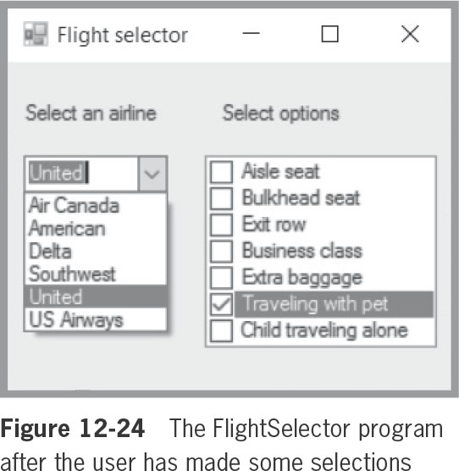
Adding ListBox, CheckedListBox, and ComboBox Controls to a Form (7 of 7)
© 2018 Cengage. May not be copied, scanned, or duplicated, in whole or in part, except for use as permitted in a license distributed with a certain product or service or otherwise on a password-protected website for classroom use.

Slide 34
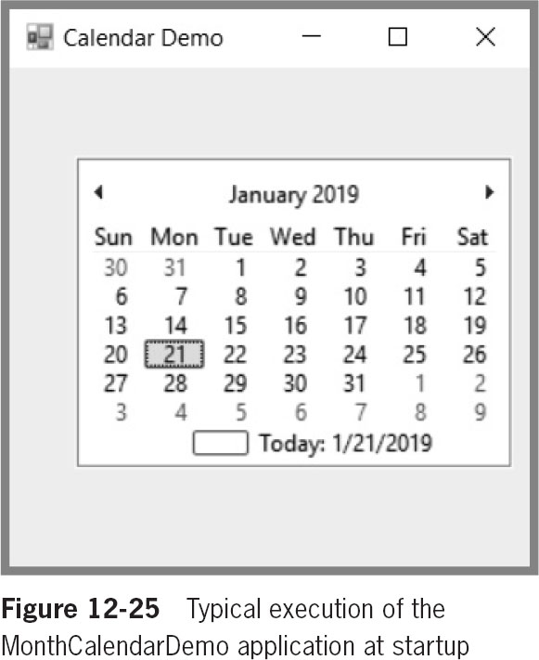
Adding MonthCalendar and DateTimePicker Controls to a Form (1 of 5)
MonthCalendar and DateTimePicker Controls
Allow you to retrieve date and time information
© 2018 Cengage. May not be copied, scanned, or duplicated, in whole or in part, except for use as permitted in a license distributed with a certain product or service or otherwise on a password-protected website for classroom use.

Slide 35
Adding MonthCalendar and DateTimePicker Controls to a Form (2 of 5)
Several useful methods can be applied to the SelectionStart and SelectionEnd properties of MonthCalendar, including:
ToShortDateString() – displays the date in the format 1/21/2019
ToLongDateString() – which displays the date in the format of Monday, January 21, 2019
AddDays() – takes a double argument and adds a specified number of days to the date
AddMonths() – takes an int argument and adds a specified number of months to the date
AddYears() – takes an int argument and adds a specified number of years to the date
© 2018 Cengage. May not be copied, scanned, or duplicated, in whole or in part, except for use as permitted in a license distributed with a certain product or service or otherwise on a password-protected website for classroom use.

Slide 36
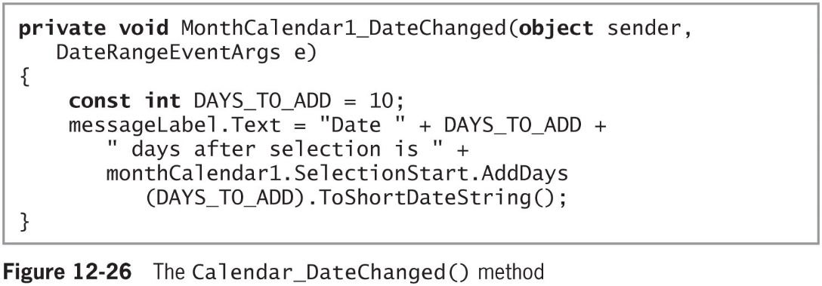
Adding MonthCalendar and DateTimePicker Controls to a Form (3 of 5)
Figure 12-26 shows a method that executes when the user clicks a MonthCalendar named monthCalendar1
© 2018 Cengage. May not be copied, scanned, or duplicated, in whole or in part, except for use as permitted in a license distributed with a certain product or service or otherwise on a password-protected website for classroom use.

Slide 37
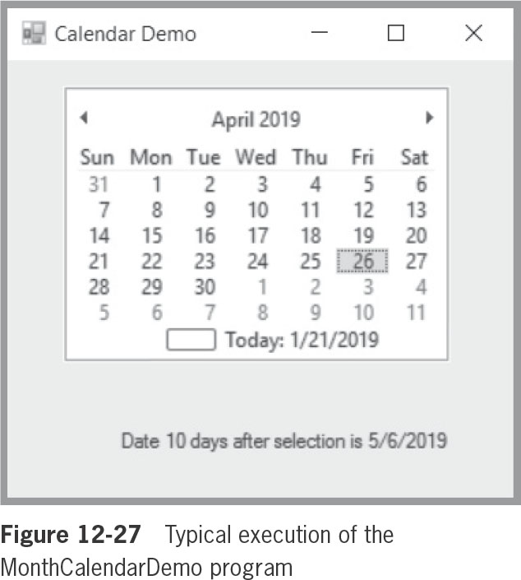
Adding MonthCalendar and DateTimePicker Controls to a Form (4 of 5)
Figure 12-27 shows the output when the user selects April 26, 2019
© 2018 Cengage. May not be copied, scanned, or duplicated, in whole or in part, except for use as permitted in a license distributed with a certain product or service or otherwise on a password-protected website for classroom use.

Slide 38
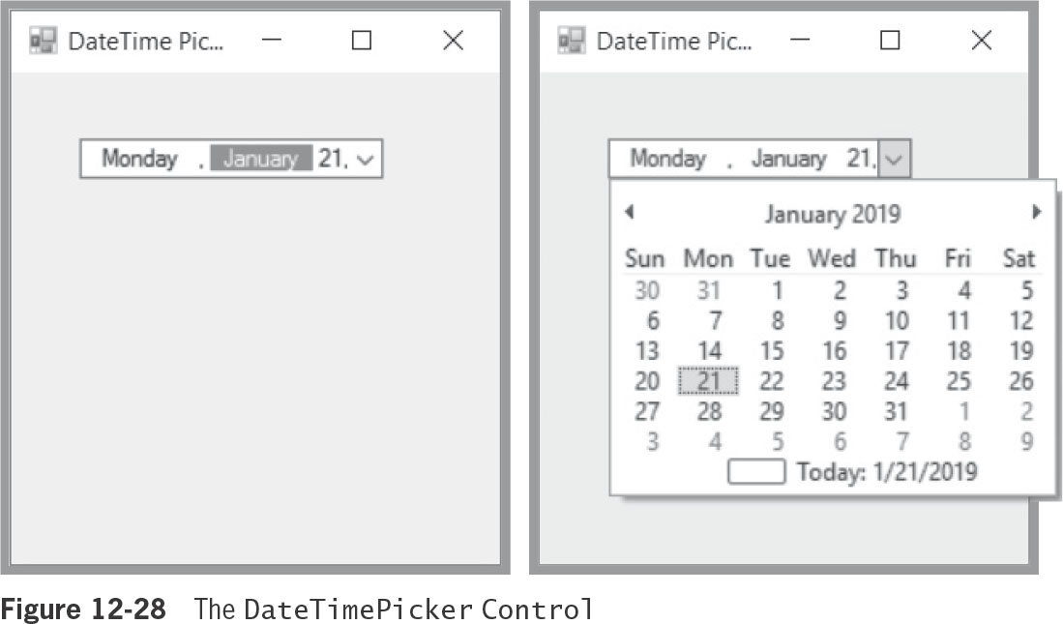
Adding MonthCalendar and DateTimePicker Controls to a Form (5 of 5)
DateTimePicker Control
Displays a month calendar when the down arrow is selected
© 2018 Cengage. May not be copied, scanned, or duplicated, in whole or in part, except for use as permitted in a license distributed with a certain product or service or otherwise on a password-protected website for classroom use.

Slide 39
Working with a Form’s Layout (1 of 7)
Blue snap lines
Appear when you drag multiple Controls onto a Form
Help align new Controls with others already in place
Appear when you place a control closer to the edge of a container than is recommended
Can use the Location property in the Properties list to specify a location
© 2018 Cengage. May not be copied, scanned, or duplicated, in whole or in part, except for use as permitted in a license distributed with a certain product or service or otherwise on a password-protected website for classroom use.

Slide 40
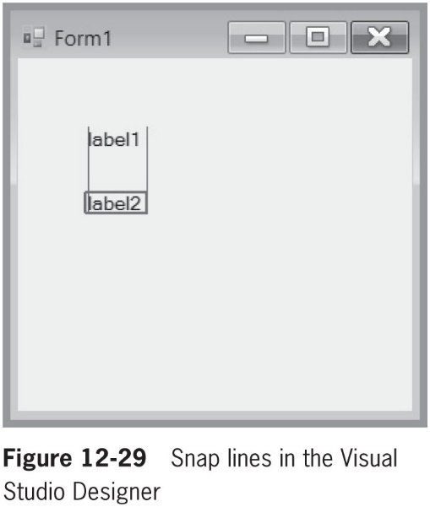
Working with a Form’s Layout (2 of 7)
© 2018 Cengage. May not be copied, scanned, or duplicated, in whole or in part, except for use as permitted in a license distributed with a certain product or service or otherwise on a password-protected website for classroom use.

Slide 41
Working with a Form’s Layout (3 of 7)
Anchor property
Causes a Control to remain at a fixed distance from the side of a container when the user resizes it
Dock property
Attaches a Control to the side of a container so that the Control stretches when the container’s size is adjusted
Padding property
Specifies the distance between docked Controls and the edges of the Form
© 2018 Cengage. May not be copied, scanned, or duplicated, in whole or in part, except for use as permitted in a license distributed with a certain product or service or otherwise on a password-protected website for classroom use.

Slide 42
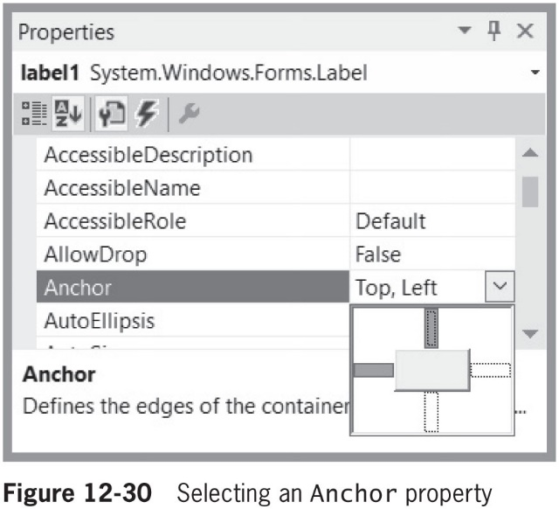
Working with a Form’s Layout (4 of 7)
© 2018 Cengage. May not be copied, scanned, or duplicated, in whole or in part, except for use as permitted in a license distributed with a certain product or service or otherwise on a password-protected website for classroom use.

Slide 43
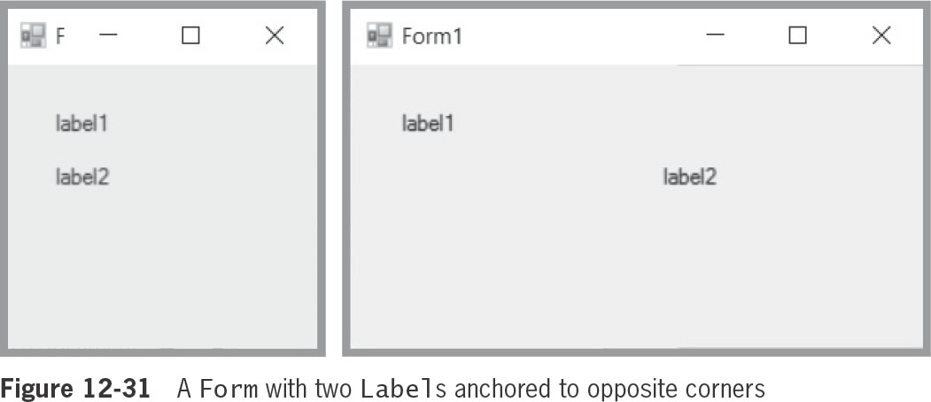
Working with a Form’s Layout (5 of 7)
© 2018 Cengage. May not be copied, scanned, or duplicated, in whole or in part, except for use as permitted in a license distributed with a certain product or service or otherwise on a password-protected website for classroom use.

Slide 44
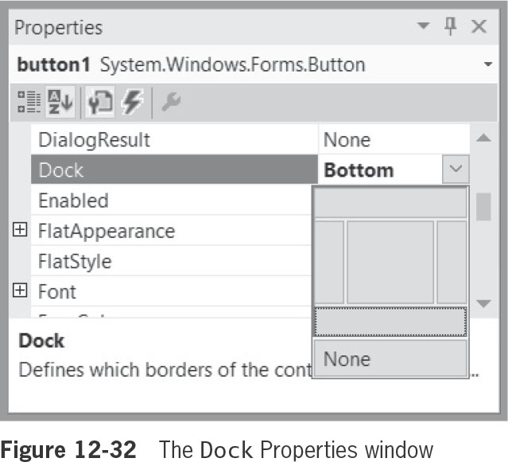
Working with a Form’s Layout (6 of 7)
© 2018 Cengage. May not be copied, scanned, or duplicated, in whole or in part, except for use as permitted in a license distributed with a certain product or service or otherwise on a password-protected website for classroom use.

Slide 45
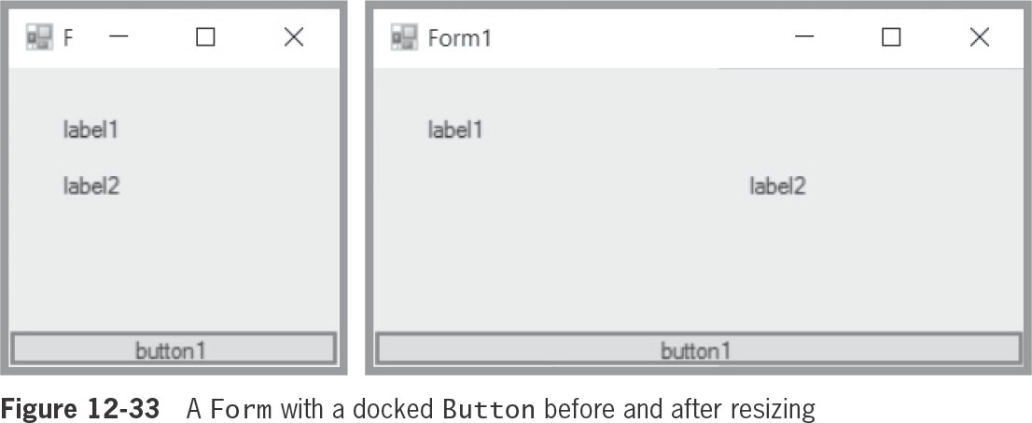
Working with a Form’s Layout (7 of 7)
© 2018 Cengage. May not be copied, scanned, or duplicated, in whole or in part, except for use as permitted in a license distributed with a certain product or service or otherwise on a password-protected website for classroom use.

Slide 46
Understanding GroupBoxes and Panels
GroupBox or Panel
Container Controls to hold other Controls on a Form
Can be anchored or docked inside a Form
GroupBoxes
Can display a caption
Do not have scroll bars
Panels
Cannot display a caption
Have scroll bars
© 2018 Cengage. May not be copied, scanned, or duplicated, in whole or in part, except for use as permitted in a license distributed with a certain product or service or otherwise on a password-protected website for classroom use.

Slide 47
Adding a MenuStrip to a Form (1 of 2)
Menu strip
A horizontal list of general options that appears under the title bar of a Form or Window
You can add a MenuStrip Control object to any Form you create
When you double-click an entry in the MenuStrip, a Click() method is generated
© 2018 Cengage. May not be copied, scanned, or duplicated, in whole or in part, except for use as permitted in a license distributed with a certain product or service or otherwise on a password-protected website for classroom use.

Slide 48
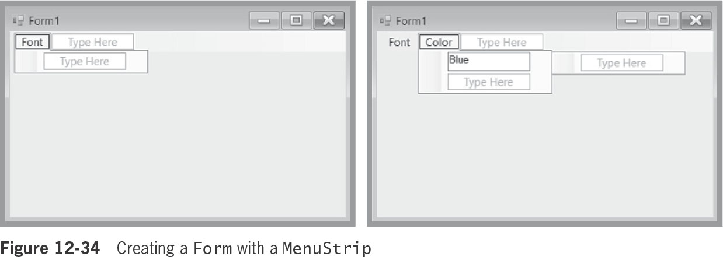
Adding a MenuStrip to a Form (2 of 2)
© 2018 Cengage. May not be copied, scanned, or duplicated, in whole or in part, except for use as permitted in a license distributed with a certain product or service or otherwise on a password-protected website for classroom use.

Slide 49
Using Other Controls
If you click Project on the main menu and click Add New Item, you can add extra Forms, Files, Controls, and other elements to your project
© 2018 Cengage. May not be copied, scanned, or duplicated, in whole or in part, except for use as permitted in a license distributed with a certain product or service or otherwise on a password-protected website for classroom use.

Slide 50
Chapter Summary (1 of 3)
The Control class provides definitions for GUI objects such as Forms and Buttons
Much of the code for GUI applications is generated automatically using the Visual Studio IDE
Use the Font class to change the appearance of printed text on your Forms
LinkLabel allows you to link the user to other sources, such as Web pages or files
The Color class has a variety of predefined Colors
© 2018 Cengage. May not be copied, scanned, or duplicated, in whole or in part, except for use as permitted in a license distributed with a certain product or service or otherwise on a password-protected website for classroom use.

Slide 51
Chapter Summary (2 of 3)
CheckBox objects are GUI widgets the user can click to select or deselect an option
A PictureBox displays graphics from a bitmap, icon, JPEG, GIF, or other image file type
ListBox, ComboBox, and CheckedListBox objects descend from ListControl
MonthCalendar and DateTimePicker Controls allow you to retrieve date and time info
When you place Controls on a Form in the IDE, you can drag them to any location to achieve the effect you want
© 2018 Cengage. May not be copied, scanned, or duplicated, in whole or in part, except for use as permitted in a license distributed with a certain product or service or otherwise on a password-protected website for classroom use.

Slide 52
Chapter Summary (3 of 3)
Many types of ContainerControls are available to hold Controls
Most programs in a Windows environment contain a menu strip
Many other Controls are available
© 2018 Cengage. May not be copied, scanned, or duplicated, in whole or in part, except for use as permitted in a license distributed with a certain product or service or otherwise on a password-protected website for classroom use.

